Slide 1
CP6 Presentation

Slide 2
Topic
Distributed-memory parallel version
of Sobel filter with the Message Passing Interface (MPI) utilizing Varied Grid Decomposition Strategies

Slide 3
Objective
analyze and compare the performance of an MPI-based Sobel filter application using different grid decomposition strategies
The expected outcome is to gain insights into optimizing MPI-based applications for better performance and scalability

Slide 4
Methodology
Experimental Setup: Conducted on the Perlmutter system at NERSC using its CPU nodes and the Cray MPICH MPI environment for high-performance parallel computing.
Sobel Filter Implementation: Parallelized using MPI, distributing image processing tasks across multiple compute nodes to implement the Sobel edge detection algorithm.
Grid Decomposition Strategies: Evaluated performance impacts using three strategies: row-slab, column-slab, and tiled.
Data Collection and Performance Metrics: Measured runtime for scatter, process, and gather stages. Collected data on the number of messages sent and total data moved. Analyzed metrics focused on runtime speedup, communication overhead, and data movement efficiency across different concurrency levels.

Slide 5
Code harness
sobelAllTiles
This function designed to integrate the Sobel edge detection algorithm into a parallel computing framework using MPI. It ensures that each MPI process works on a specific part of the image, thereby leveraging the power of distributed computing to efficiently process large images.
scatterAllTiles
This function is instrumental in distributing segments of an image (tiles) across different MPI ranks for parallel processing. If rank = 0 it going to send the data to another rank, otherwise it going to receive the tile from rank 0

Slide 6
Code harness
gatherAllTiles
This function in the plays a crucial role in aggregating processed image segments (tiles) from various MPI ranks. If rank is other than 0, it going to send the processed tile to rank 0. If the rank is 0, it going to receive processed data from other rank.

Slide 7
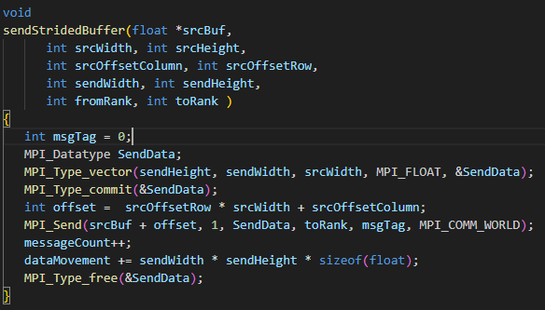
Code implementation
sendStridedBuffer
function call is responsible for sending a specifically defined subregion of a data buffer from one MPI process to another, using a custom data type to accurately describe the shape and size of the data segment being transmitted
Also keep track on message count and how much data is transferred for further analysis

Slide 8
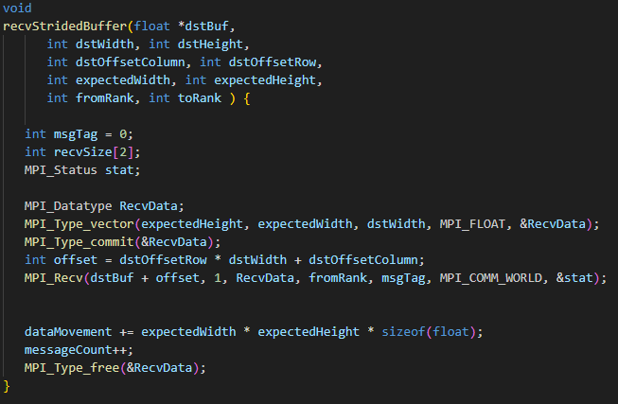
Code implementation
recvStridedBuffer
Similar to sendStridedBuffer but for receive end

Slide 9
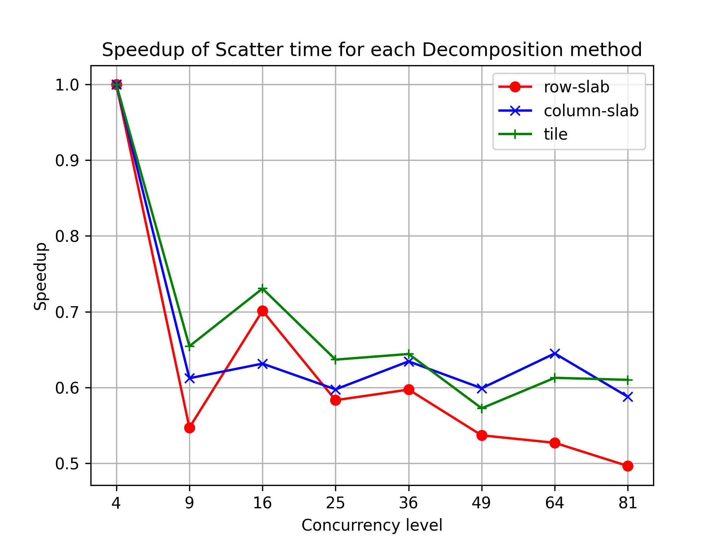
result
Scatter Speedup
In the scatter stage, all strategies showed a decrease in speedup as concurrency increased, with the row-slab strategy exhibiting the most decline. The tile strategy maintained a superior speedup at lower concurrency levels but experienced a significant reduction at a concurrency level of 9

Slide 10
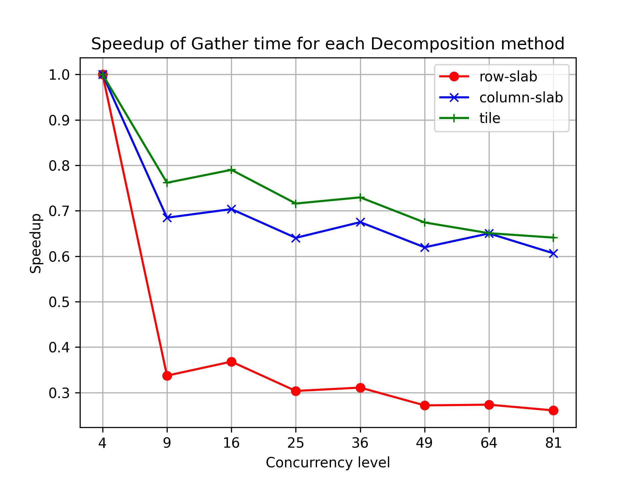
result
gather stage, the tile strategy achieved the highest speedup at lower concurrency levels, suggesting a more efficient reassembly process. Conversely, the row-slab strategy demonstrated a consistent decrease in speedup as concurrency levels rose, indicating potential data collection bottlenecks

Slide 11
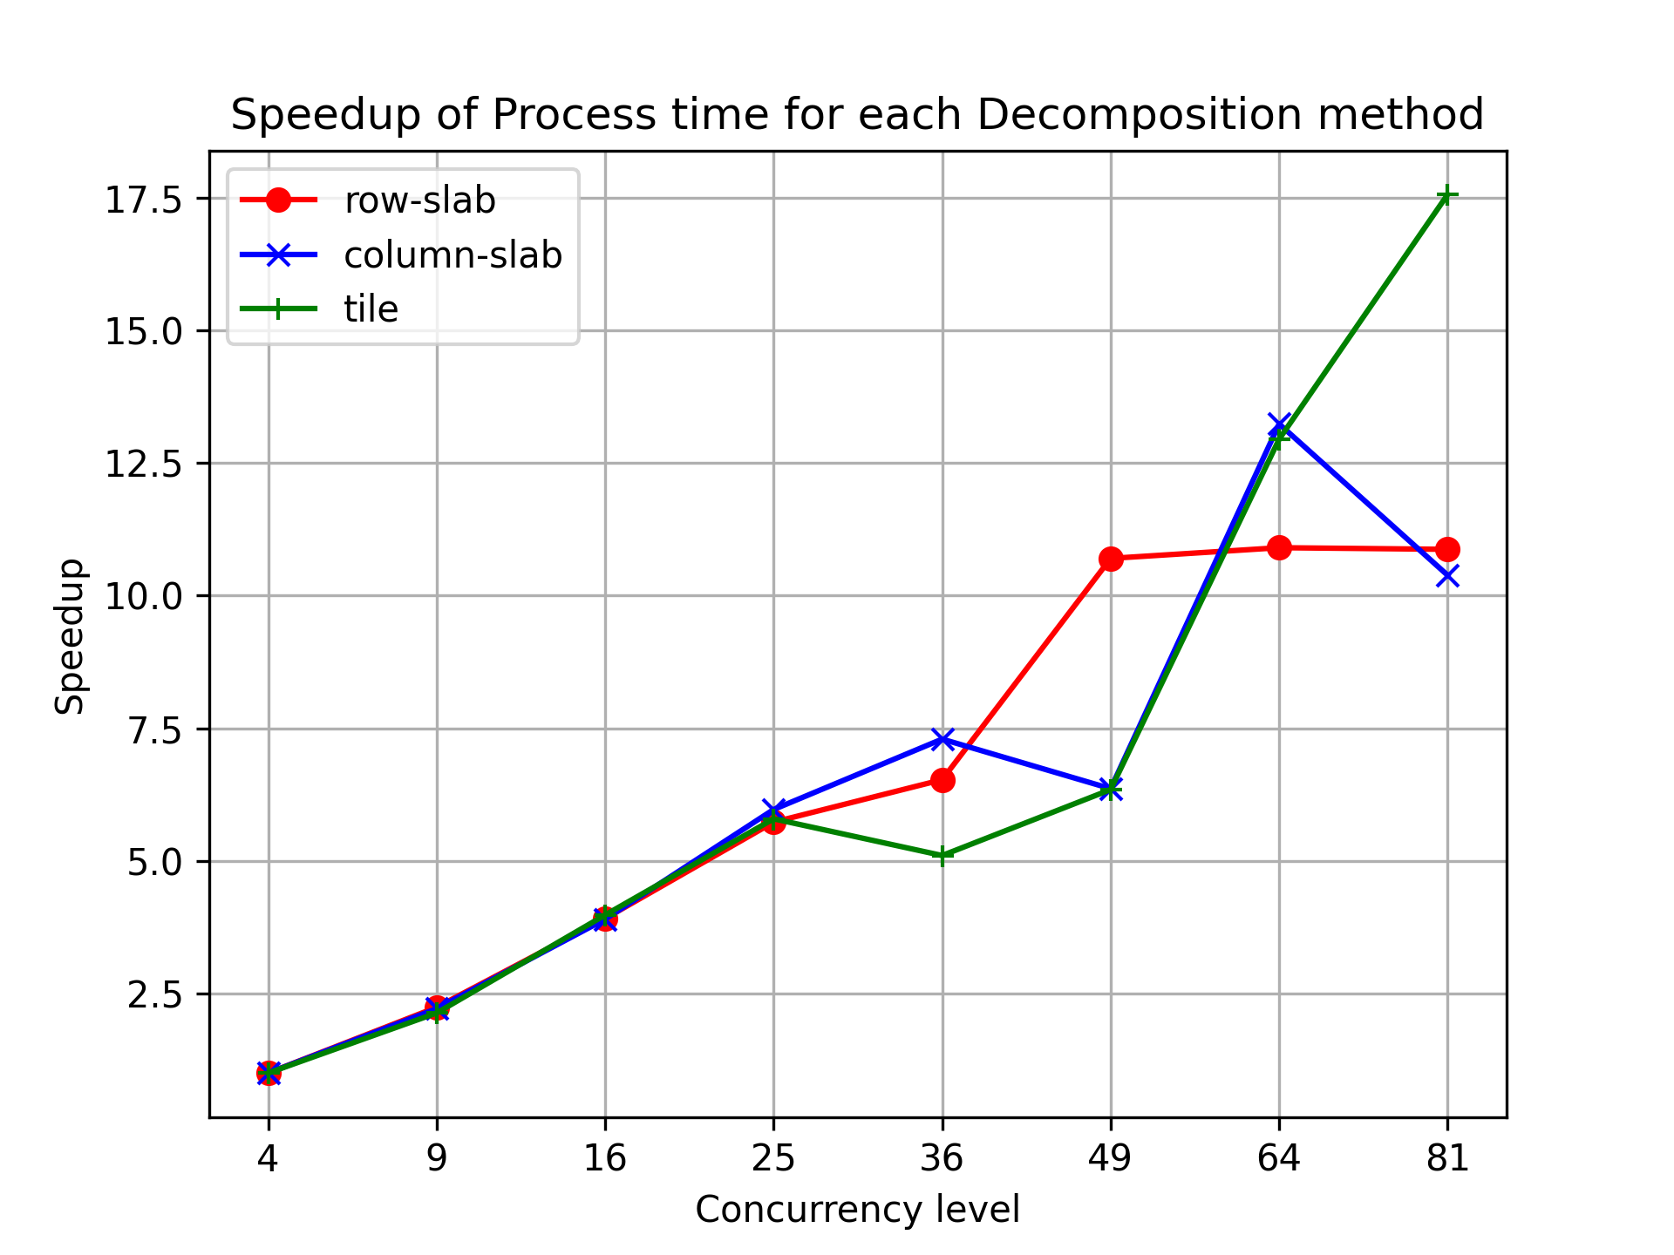
Result
Process speed up
The process stage revealed a marked improvement in speedup for all strategies with increasing concurrency levels, particularly noticeable for the tile strategy at the highest concurrency level of 81. Row-slab and column-slab strategies displayed similar performance until a concurrency level of 64, after which the tile strategy's speedup surged ahead

Slide 12
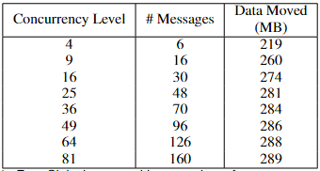
Result
Communication efficiency
As concurrency grows, so does the communication load, regardless of the decomposition method. This increase is linear for message counts and data volume.

